Slide 1
Access to Resources in the Community (ARC)
Simone Dahrouge, PhD
Rachelle Ashcroft, PhD
Marie-Hélène Chomienne, MD, MSc
Kim Corace, PhD
Lisa Dolovich, PhD
John Hoyles
Denis Prud’homme, MD, MSc
Kamila Premji, MD, PhD
Jennifer Rayner, PhD
Kednapa Thavorn, PhD
Meltem Tuna, PhD
Merrick Zwarenstein, PhD
Claire Kendall, MD, PhD
Laura Muldoon, MD
Justin Presseau, PhD
Alain Gauthier
Patrick Timony
Francois Durand
Karen James
Suzanne Obiorah, RD, MBA
Darene Toal-Sullivan, PhD, OT. Natacha Ndihokubwayo, SSW, BA
Carolynn Warnet, MBE
Nicholas Kathen, BSc
Kiran Saluja, PhD

Slide 2
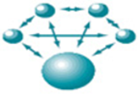
Access to Health Enabling Resources is low and inequitable
Patients Primary Care Providers
.
Limited ability to NAVIGATE a complex system
Lack of SUPPORT to overcome barriers
.
Limited AWARENESS of resources
Limited TIME
to provide support
Care Providers
Patient Partners
ARC
Service providers
Health Planners
Researchers
Notes:
Many health and social needs are unmet (those that address healthy behaviours, social determinants of health)
Resources to address these are available in the community and through government programs
Patient told us that have difficulty navigating the system, what is available, where, for whom, how to register,….
Patients commonly face barriers they are unable to overcome alone. Financial, transportation, find the service in their language,…
They need support, but many don’t have that
These issues are especially important for individuals who are more social complex and who could most benefit from the navigation service.
PCP are best positioned to support patients address their health and social needs. This is highlighted in the 2019 addition of the social accountability pillar to the College of Family Physicians of Canada’s Patient Centered Medical Home
It’s not possible for PCP to know all the services available; and
Access to Resources In the Community (ARC) is a patient-centered navigation model integrated in primary care practices with the intention to help individuals accesses resources that can address their health and social needs.

Slide 3
Description of model
Patient Centered Navigation
Addresses Barriers to Access
Notes:
One navigator can support several practices
Referral to the navigation services are integrated in the EMR (just like referrals to specialists). PCP refer individuals needing assistance to address unmet health or social needs.
The navigator is given an encounter room and times when its available to them to meet with practice patients. They can meet at the practice, by telephone, or other means according to patient preference.
At their first meeting, the navigator elicits information about their needs and anticipated barriers, and then works with them to eventually find the most appropriate resource for that person, and helps them address access barriers. Commonly these include financial barriers, completing forms, motivation/confidence to call.
The relationship between the navigator and the practice can vary from being an external resources exchanging fax communications about their patient progress, or as a team member, charting in the EMR

Slide 4
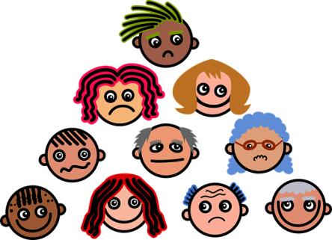
Benefits and Key to Success
Embeded in Primary Care
Broad Reach
Facilitates needs identification
Improves compliance
Primary care-Community
Promotes integration & information continuity
Navigator
Lay individual
Applies motivational interviewing + follows up until resolution
Identifies and Addresses barriers
Patient Centered Navigation
Addresses Barriers to Access
System Level Benefit
Address important system gap
Available to all = Reduces system fragmentation
Reduces inequities across PC models
Whole Person Navigation
Reduces care fragmentation
Patient-centered
Health related, Health behaviour &Social Dedterminants of Health
Notes:
Access to Resources In the Community (ARC) is a patient-centered navigation model integrated in primary care practices with the intention to help individuals accesses resources that can address their health and social needs. The model utilizes a Patient Navigator who supports patients by finding local resources in their community.

Slide 5
Limitations & Challenges
Insufficient for individuals with need for ongoing support
Patient readiness
Costs

Slide 6
Valued by Participants Patients Non IP-Providers

Slide 7
Potential Impact for Mitigating Inequities

Slide 8
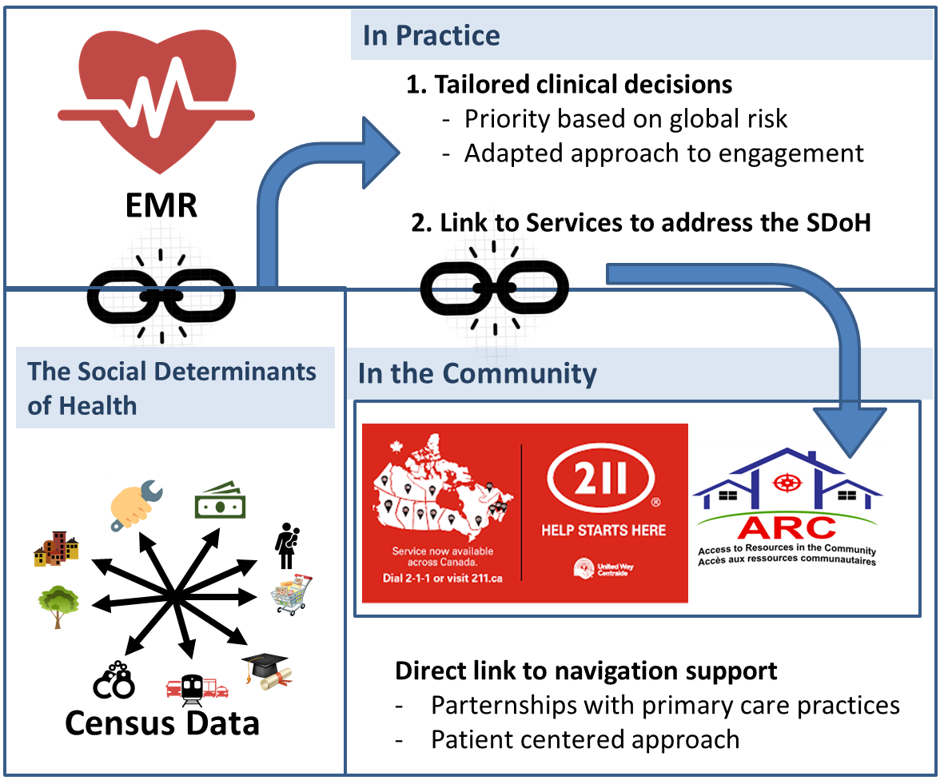
Our Vision

Slide 9
Summary
WHO is the target population and how are they reached? | WHAT is the key aspect of the intervention? | HOW does this intervention help?
Any individual requiring navigation support for health or social need | Lay Navigator embedded in primary care, applying patient centered communication | Helps reduce unmet needs

Slide 10
Additional Resources
Email address: sdahrouge@bruyere.org
Twitter: @ARCNavProject
Facebook: @accesstoresourcesinthecommunityproject
Instagram: @arcnavproject
Website: www.arcnavigatorproject.com

