Slide 1
Patient Navigation to Support Equitable Access to Resources in the Community
Presented by: Iman Sabra
Simone Dahrouge (NPI), François Chiocchio (PI), Alain Gauthier (PI), Denis Prud’homme (Co-I), Justin Presseau (Co-I), Monica Taljaard (Co-I), Manon Lemonde (Co-I), Claire Kendall, (Co-I), Rose-Anne Devlin (Co-I), Marie-Hélène Chomienne (Co-I)
Bruyère Research Institute Research Day
November 24th, 2016
www.bruyere.org

Slide 2
What do we know?
Underutilized health and social resources
Low referrals rates to health promoting community services
Unmet needs and increased inequities
Notes:
What do we know?
breadth of health and social resources that address primary health care needs and promote healthy living in their community.
Underutilized health and social resources.
Because Providers and patients are largely unaware of their existence.
Referrals to health promoting community services are low
Unmet needs and increased inequities.
Individuals with social barriers are especially vulnerable to poor access.
Francophones living in minority situations face additional language barriers.

Slide 3
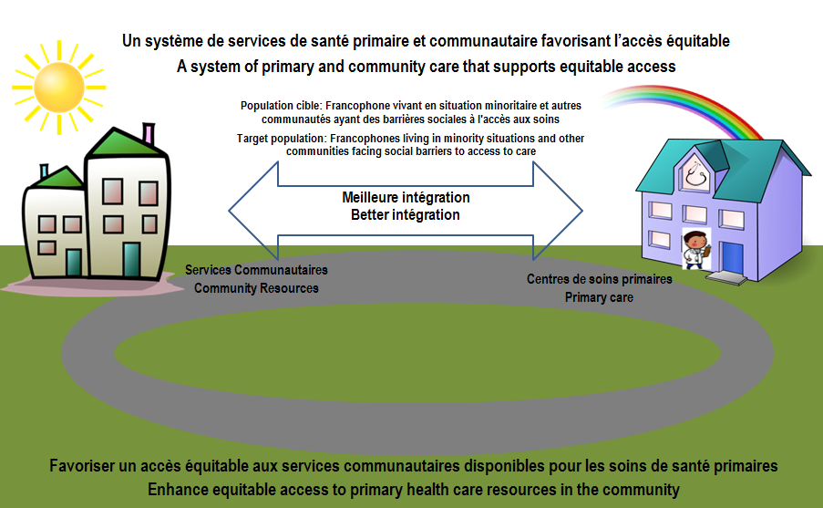
Study Aims and Objectives
Notes:
What could we do to solve these issues?
We plan on developing a system that will support and optimize equitable utilization and access to primary health care resources in the community.
Objective #1: To optimize equitable utilization of community based resources
Enhance Referrals to Community Resources
Support System Level Integration
Enhance Equitable Utilization through a Navigator
Objective #2: To inform next steps
Understand Access Experience
Understand the Elements of the Interventions

Slide 4
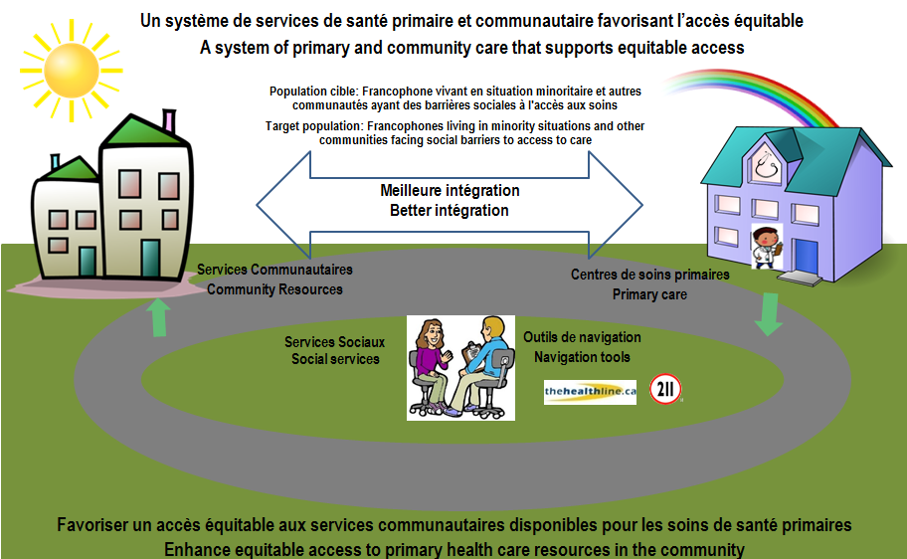
Study Aims and Objectives
Notes:
A patient navigator will be integrated in primary care practices working collaboratively with the physicians, patients and community services.

Slide 5
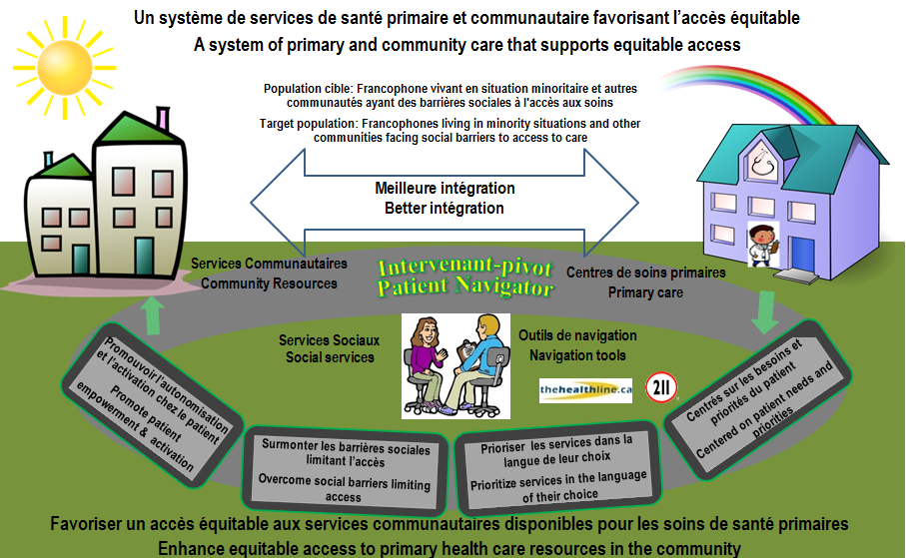
Study Aims and Objectives
Notes:
The navigator will:
Promote patient empowerment : searching, calling, asking for a service they might need.
Overcome barriers limiting access: barriers such a transportation, financial, language
Prioritize services in the language of their choice mostly for francophone populations.
Centered on patient needs and priorities: what does the patient need and what they see is the priority this might differ than what their physician identifies.
Thus this is a patient focused approach.

Slide 6
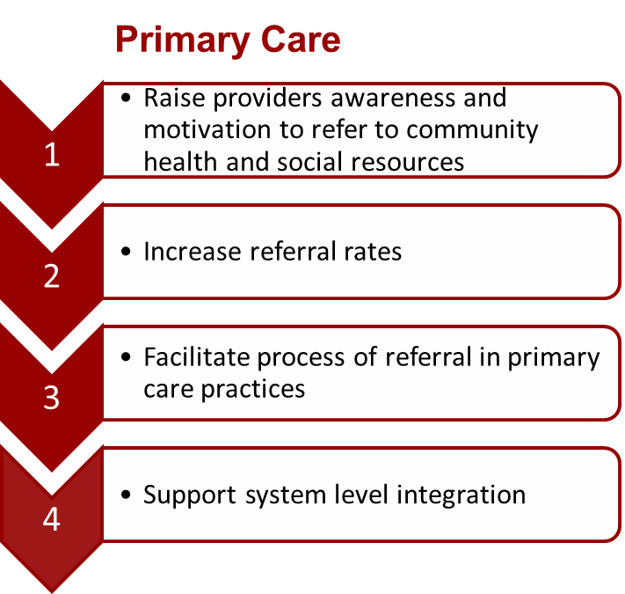
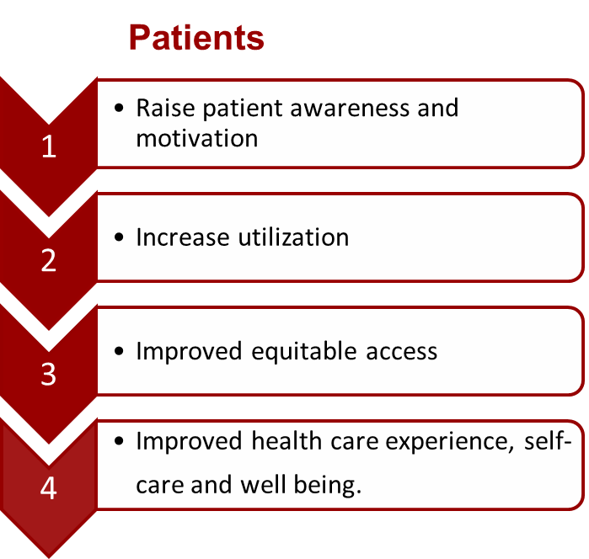
Expected Outcomes
Notes:
The intervention will:
PCP
Raise providers awareness and motivation to refer to community health and social resources
Increase referral rates to community resources.
Facilitate process of referral in primary care practices
Support system level integration Feel better equipped to address and support the needs of socially complex patients.
Patients
Raise patient awareness and motivation to access community resources.
Increase utilization of community health and social resources.
Ensure improved equitable access.
Appropriate utilization of resources, results in Improved health care experience, self-care and well being.
This study will also provide an understanding leavers and barriers to Patient Navigator implementation effectiveness with a view to provide “Best practices”.

Slide 7
Contact us
Our Partners
Principal Investigator - Simone Dahrouge, PhD
sdahrouge@bruyere.org
arc@bruyere.org
Collaborative Funding

